Slide 1
INFO1112 Tutorial
Week 10

Slide 2
Assignment 2 – Overview
Due October 22nd
Please look at Edstem before asking any questions
Attempt to read the specs
Requires you to generate a DNS infrastructure:
Change a hostname (alice.bob.carol.dan.eve) into a relevant port (2235), consider everything through this overall idea

Slide 3
Homework stuff
Homework 4 – Interviews
Homework 5 – due 15th October, 23:59:00 (this Sunday)

Slide 4
Brief summary of this week’s content

Slide 5




10.1 – Cloud Computing
What is “the cloud”?
Using computing infrastructure that’s not yours in order store, manage and process data
Used rather than relying on a personal computer or local server in an organisation
Provided by “cloud service providers”
Largest include:
Amazon Web Services (AWS)
Microsoft Azure
IBM Cloud
Google Cloud

Slide 6
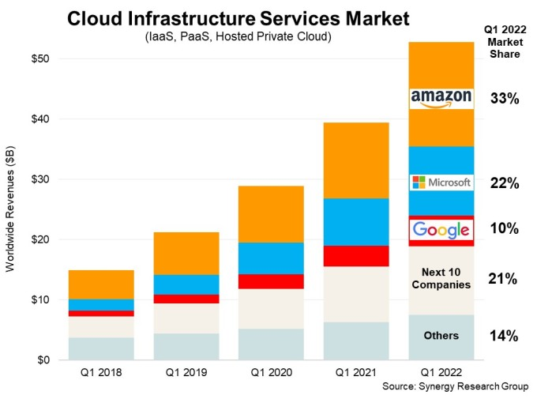
10.1 – Cloud Computing
It’s big, fast growing business!
Source: TechCrunch

Slide 7
10.1 – Cloud Computing
How are servers structured?
Servers for large organisations are distributed around the world
Closer to users – reduced latency → faster/less-delayed connections
Placed in locations with cheap and/or environmentally-friendly power
How do cloud servers work?
Providers maintain large collection of physical servers with beefy hardware
Users of providers can request access to resources that match their needs
CPU power
RAM
Storage
Provider then “spins up” virtualised environment for user
Can be virtual machine or container

Slide 8
10.1 – Cloud Computing
How can services be managed remotely?
Large providers provide an Application Programming Interface (API) to configure a cloud service
User can start, stop and configure services using an API
Usually provided via a web interface as a management console
For more direct configuration, users can also remotely SSH into a VM/container

Slide 9
10.1 – Cloud Computing
Examples of services available
Virtual Machines – have a virtual server set up to use as you need
Storage services
Simple storage, e.g. AWS S3 – store any sort of object
Backup/archival services – cheaper, but may take a lot of time to retrieve an object required
Notification services
Email services e.g. pre-configured SMTP servers – which we will explore in the lab content!
API gateway
Severless computing (more on that in next slide)

Slide 10
10.1 – Cloud Computing
What is “serverless computing”?
Rather than continuously running a server to wait for some action to occur and then perform something in response, users provide any sort of programming function that can be called when needed
Function can be called in response to some action (e.g. user performs some transaction)
Function can call other functions too
When the function is called, a VM/container is quickly generated, executes the function, and is shut down
Many languages supported

Slide 11
10.1 – Cloud Computing
Security of cloud services
Important, as services are accessed through the Internet
Requires protection to/from
Manage access to servers/resources
Malware attacks
Denial-of-service attacks
Large providers implement these protections on their own services
Large providers can also implement these services for users at a low cost

Slide 12
10.1 – Cloud Computing
The cloud and the Internet of Things (IoT)
IoT – the interconnected networks created through the many smart devices we have available today, such as:
smart lighting systems
smart appliances
cars
These devices connect to the Internet to transmit/receive information
Cloud services can:
store data from IoT devices in a centralised manner
process data produced by IoT devices – useful, as IoT devices may not have required processing power in some cases

Slide 13
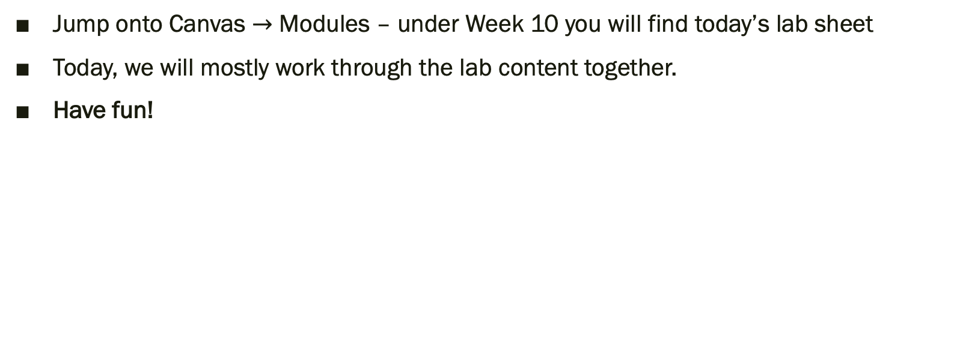
Lab exercises
Jump onto Canvas $→$ Modules – under Week 10 you will find today’s lab sheet
Today, we will mostly work through the lab content together.
Have fun!

Slide 14
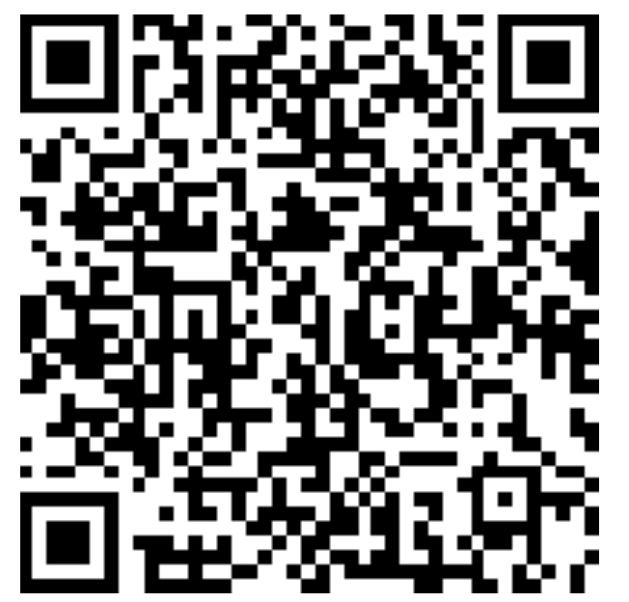
Attendance
https://bit.ly/3OrOuf9

